Slide 1
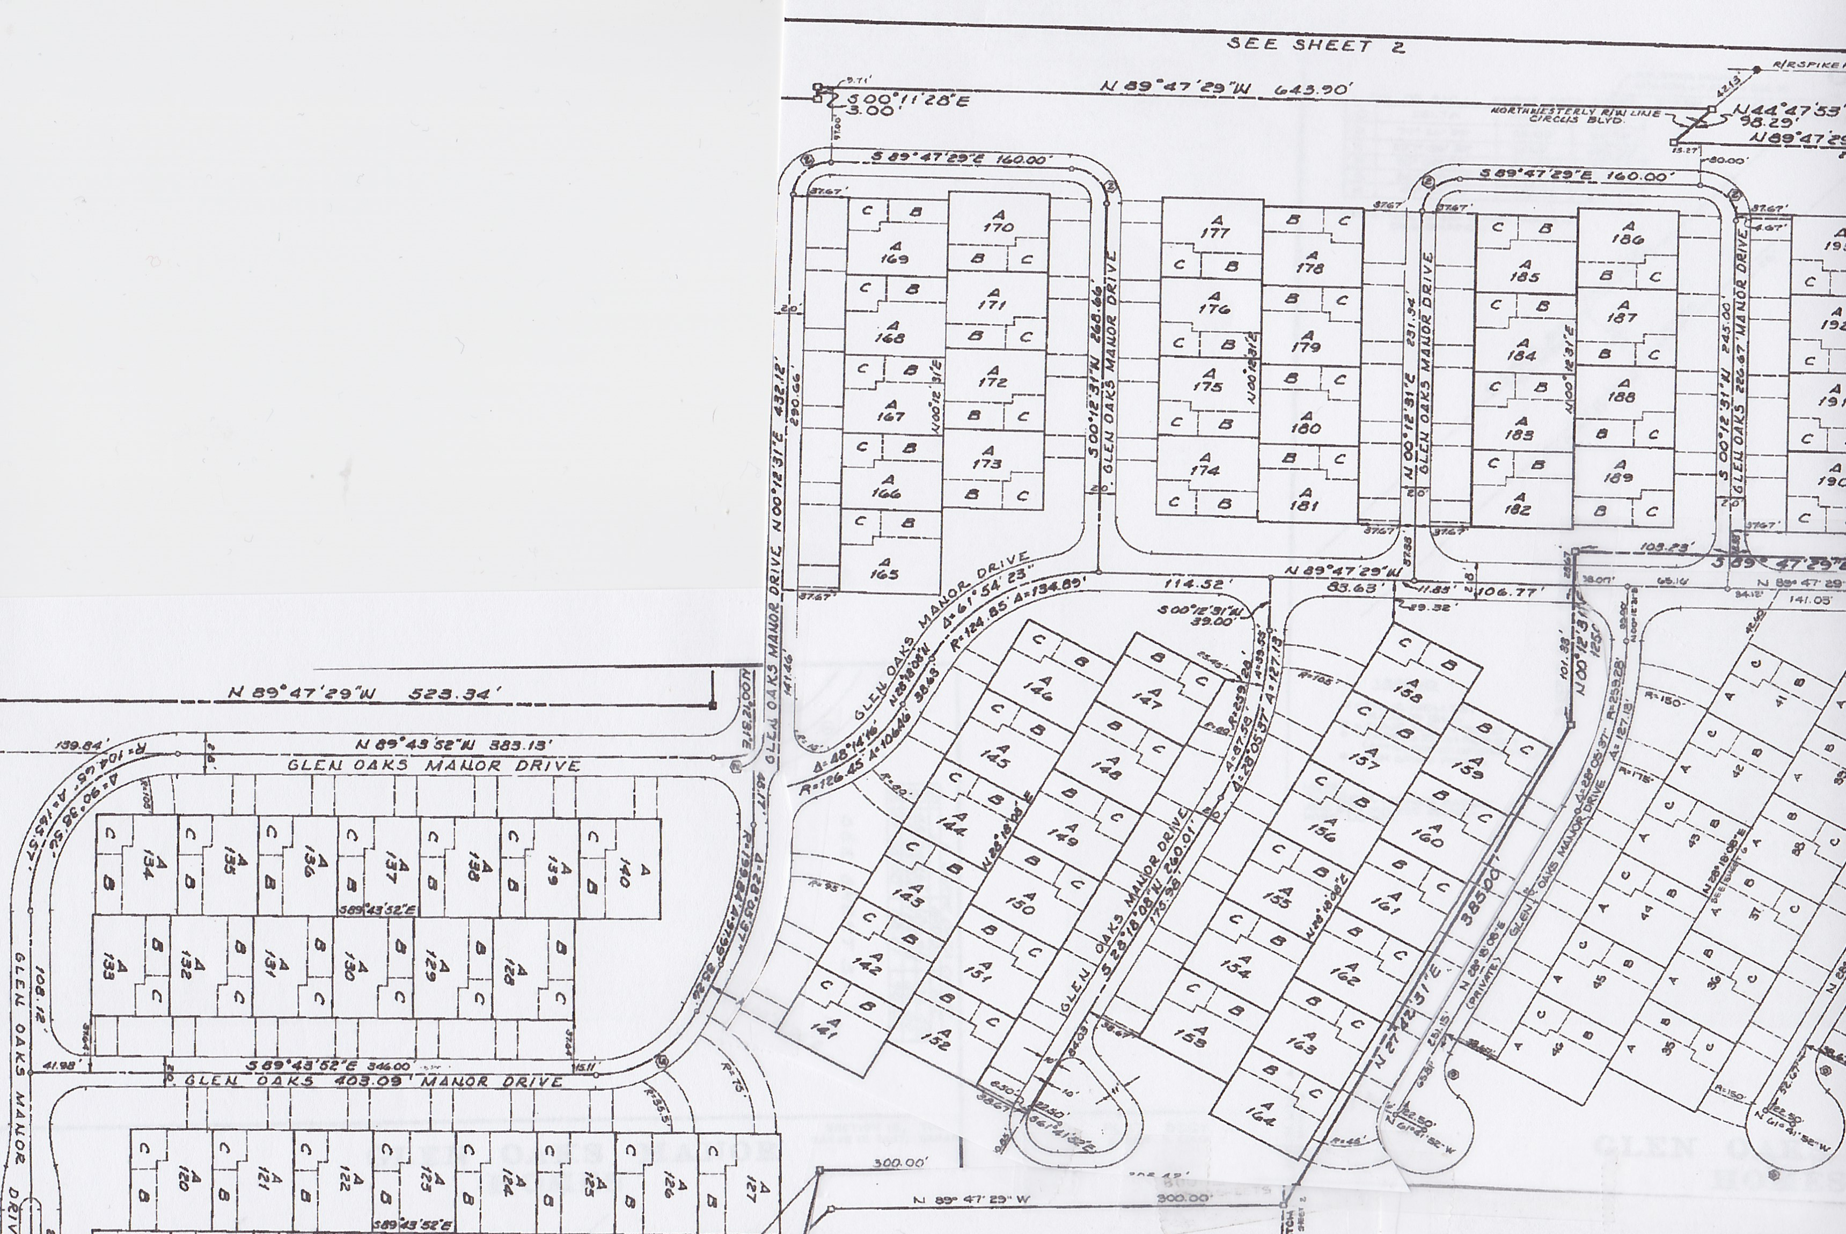
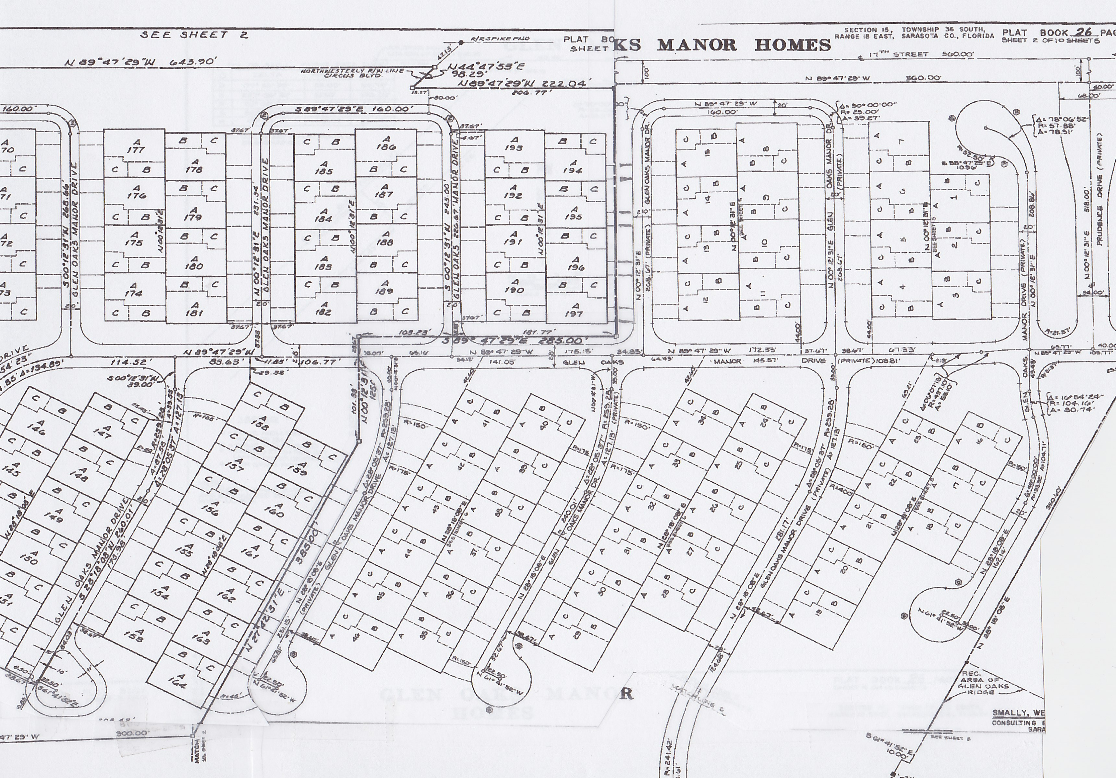
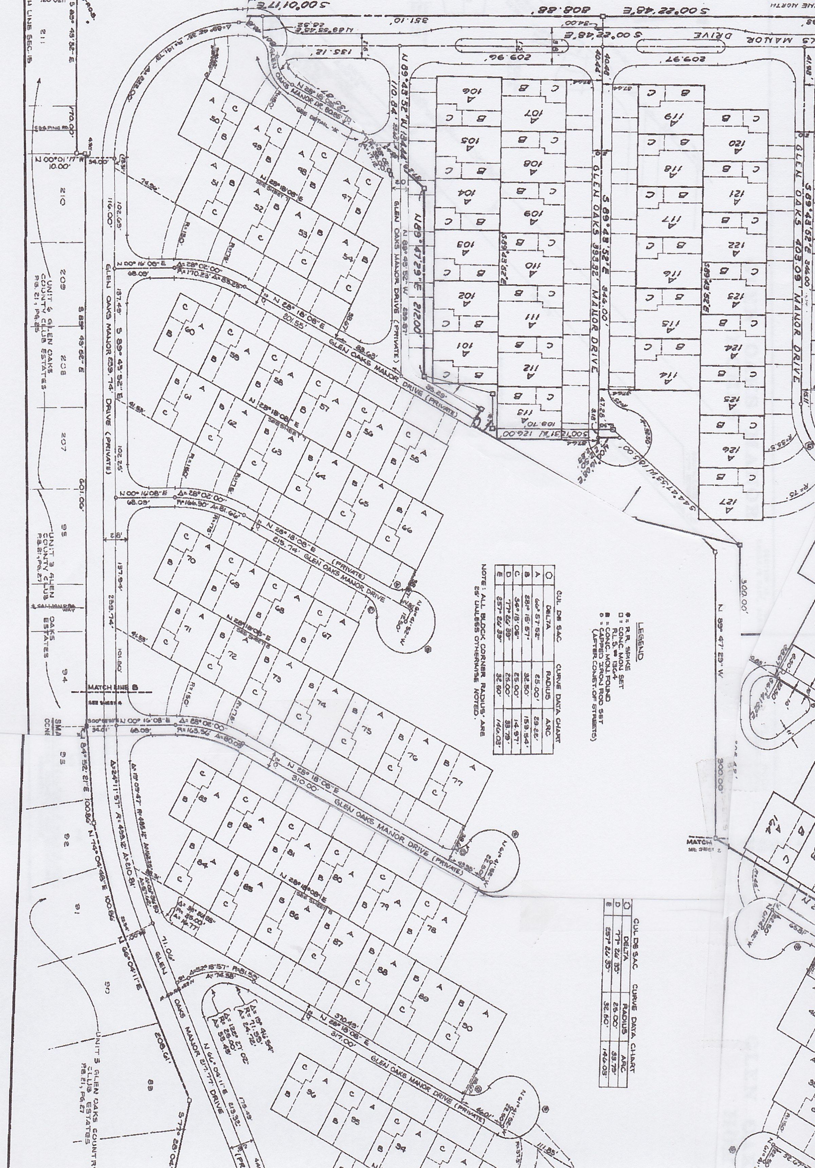
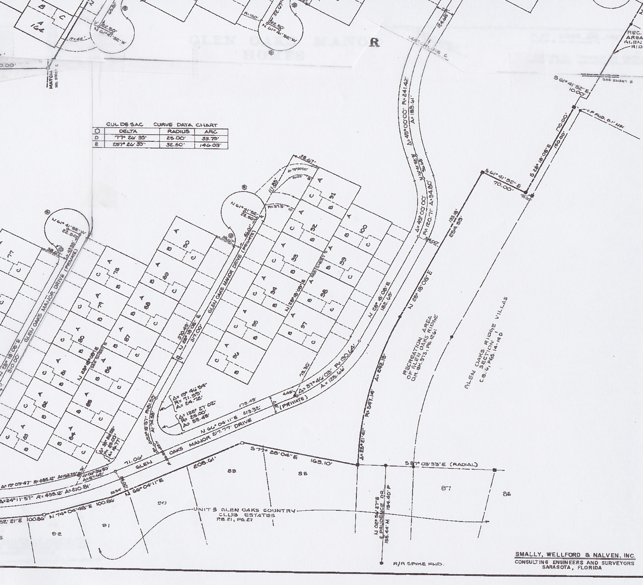
Glen Oaks Manor Drainage Map
1
#
Catch Basin
Headwall
14
12
16
33
32
35
36
#
13
15
20
34
37
5
2
19
4
3
11
18
38
7
6
17
10
9
4
5
40
39
3
Gazebo
8
2
1
Gazebo
7
6
8
30
31
21
22
23
27
Reinforced Concrete Pipe (RCP)
Pre-existing RCP
Aluminum Corrugated Pipe (ACP)
Underdrain
New High Density Polyethylene Pipe (HDPE)
Relined 2000 Relined 2024
24
25
28
26
29
Legend

Slide 2
Glen Oaks Manor Drainage Map
#
Headwall
4
5
3
Gazebo
2
1
Gazebo
7
6
8

Slide 3
Glen Oaks Manor
Gazebo
Gazebo

Slide 4
Reinforced Concrete
Pipe (RCP)
GLEN OAKS MANOR HOMES
Pre-existing RCP
Aluminum Corrugated
Pipe (ACP)
Underdrain
New High Density
Polyethylene Pipe (HDPE)
Lined in 2000

Slide 5
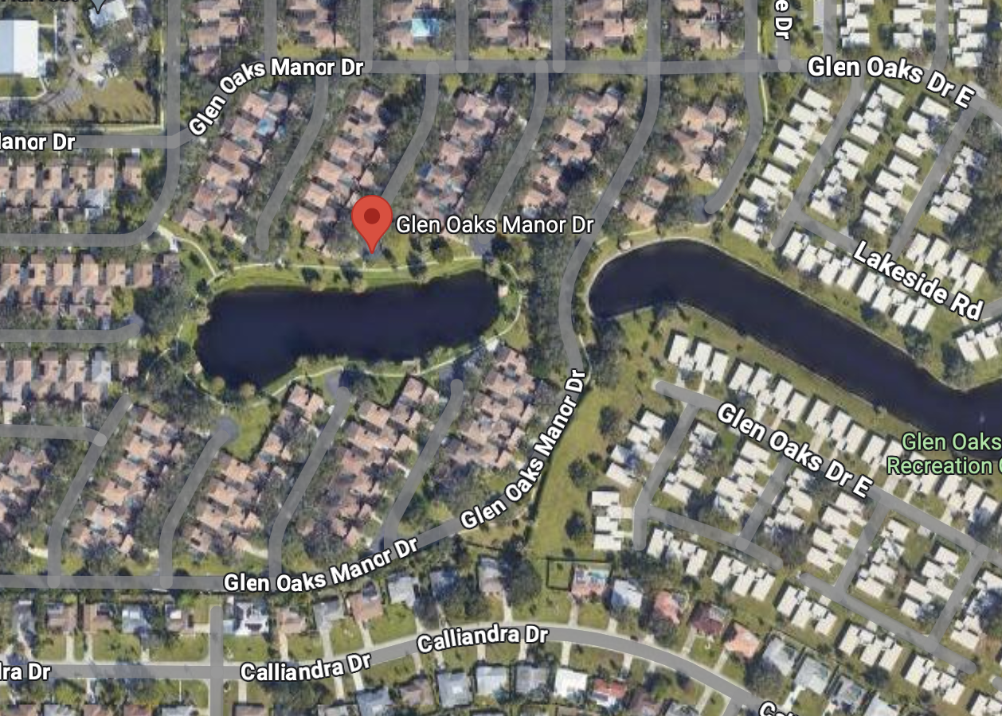
Reinforced Concrete
Pipe (RCP)
GLEN OAKS MANOR HOMES
Pre-existing RCP
1
Aluminum Corrugated
Pipe (ACP)
Underdrain
New High Density
Polyethylene Pipe (HDPE)
14
Lined in 2000
5
2
16
4
3
15
6
7
8
4
5
3
2
1
6
8
7
1

